Slide 1
Analyzing the Quality of Portuguese "Vinho Verde" Red Wine
Aged to Perfection: Red Wine Analytics
By Nahallah Champagne and Yasmeen Javadi
CS375 Introduction to Machine Learning
Project 1

Slide 2
Table of contents
01
02
03
04
Introduction
Data Visualization
What is our dataset all about?
What trends does our dataset display? How did we use this to pick a ML model?
Decision Tree
Random Forest
Decision Tree implementation and what the final accuracy score value means?
Random Forest implementation and what the final accuracy score value means?
Contents

Slide 3
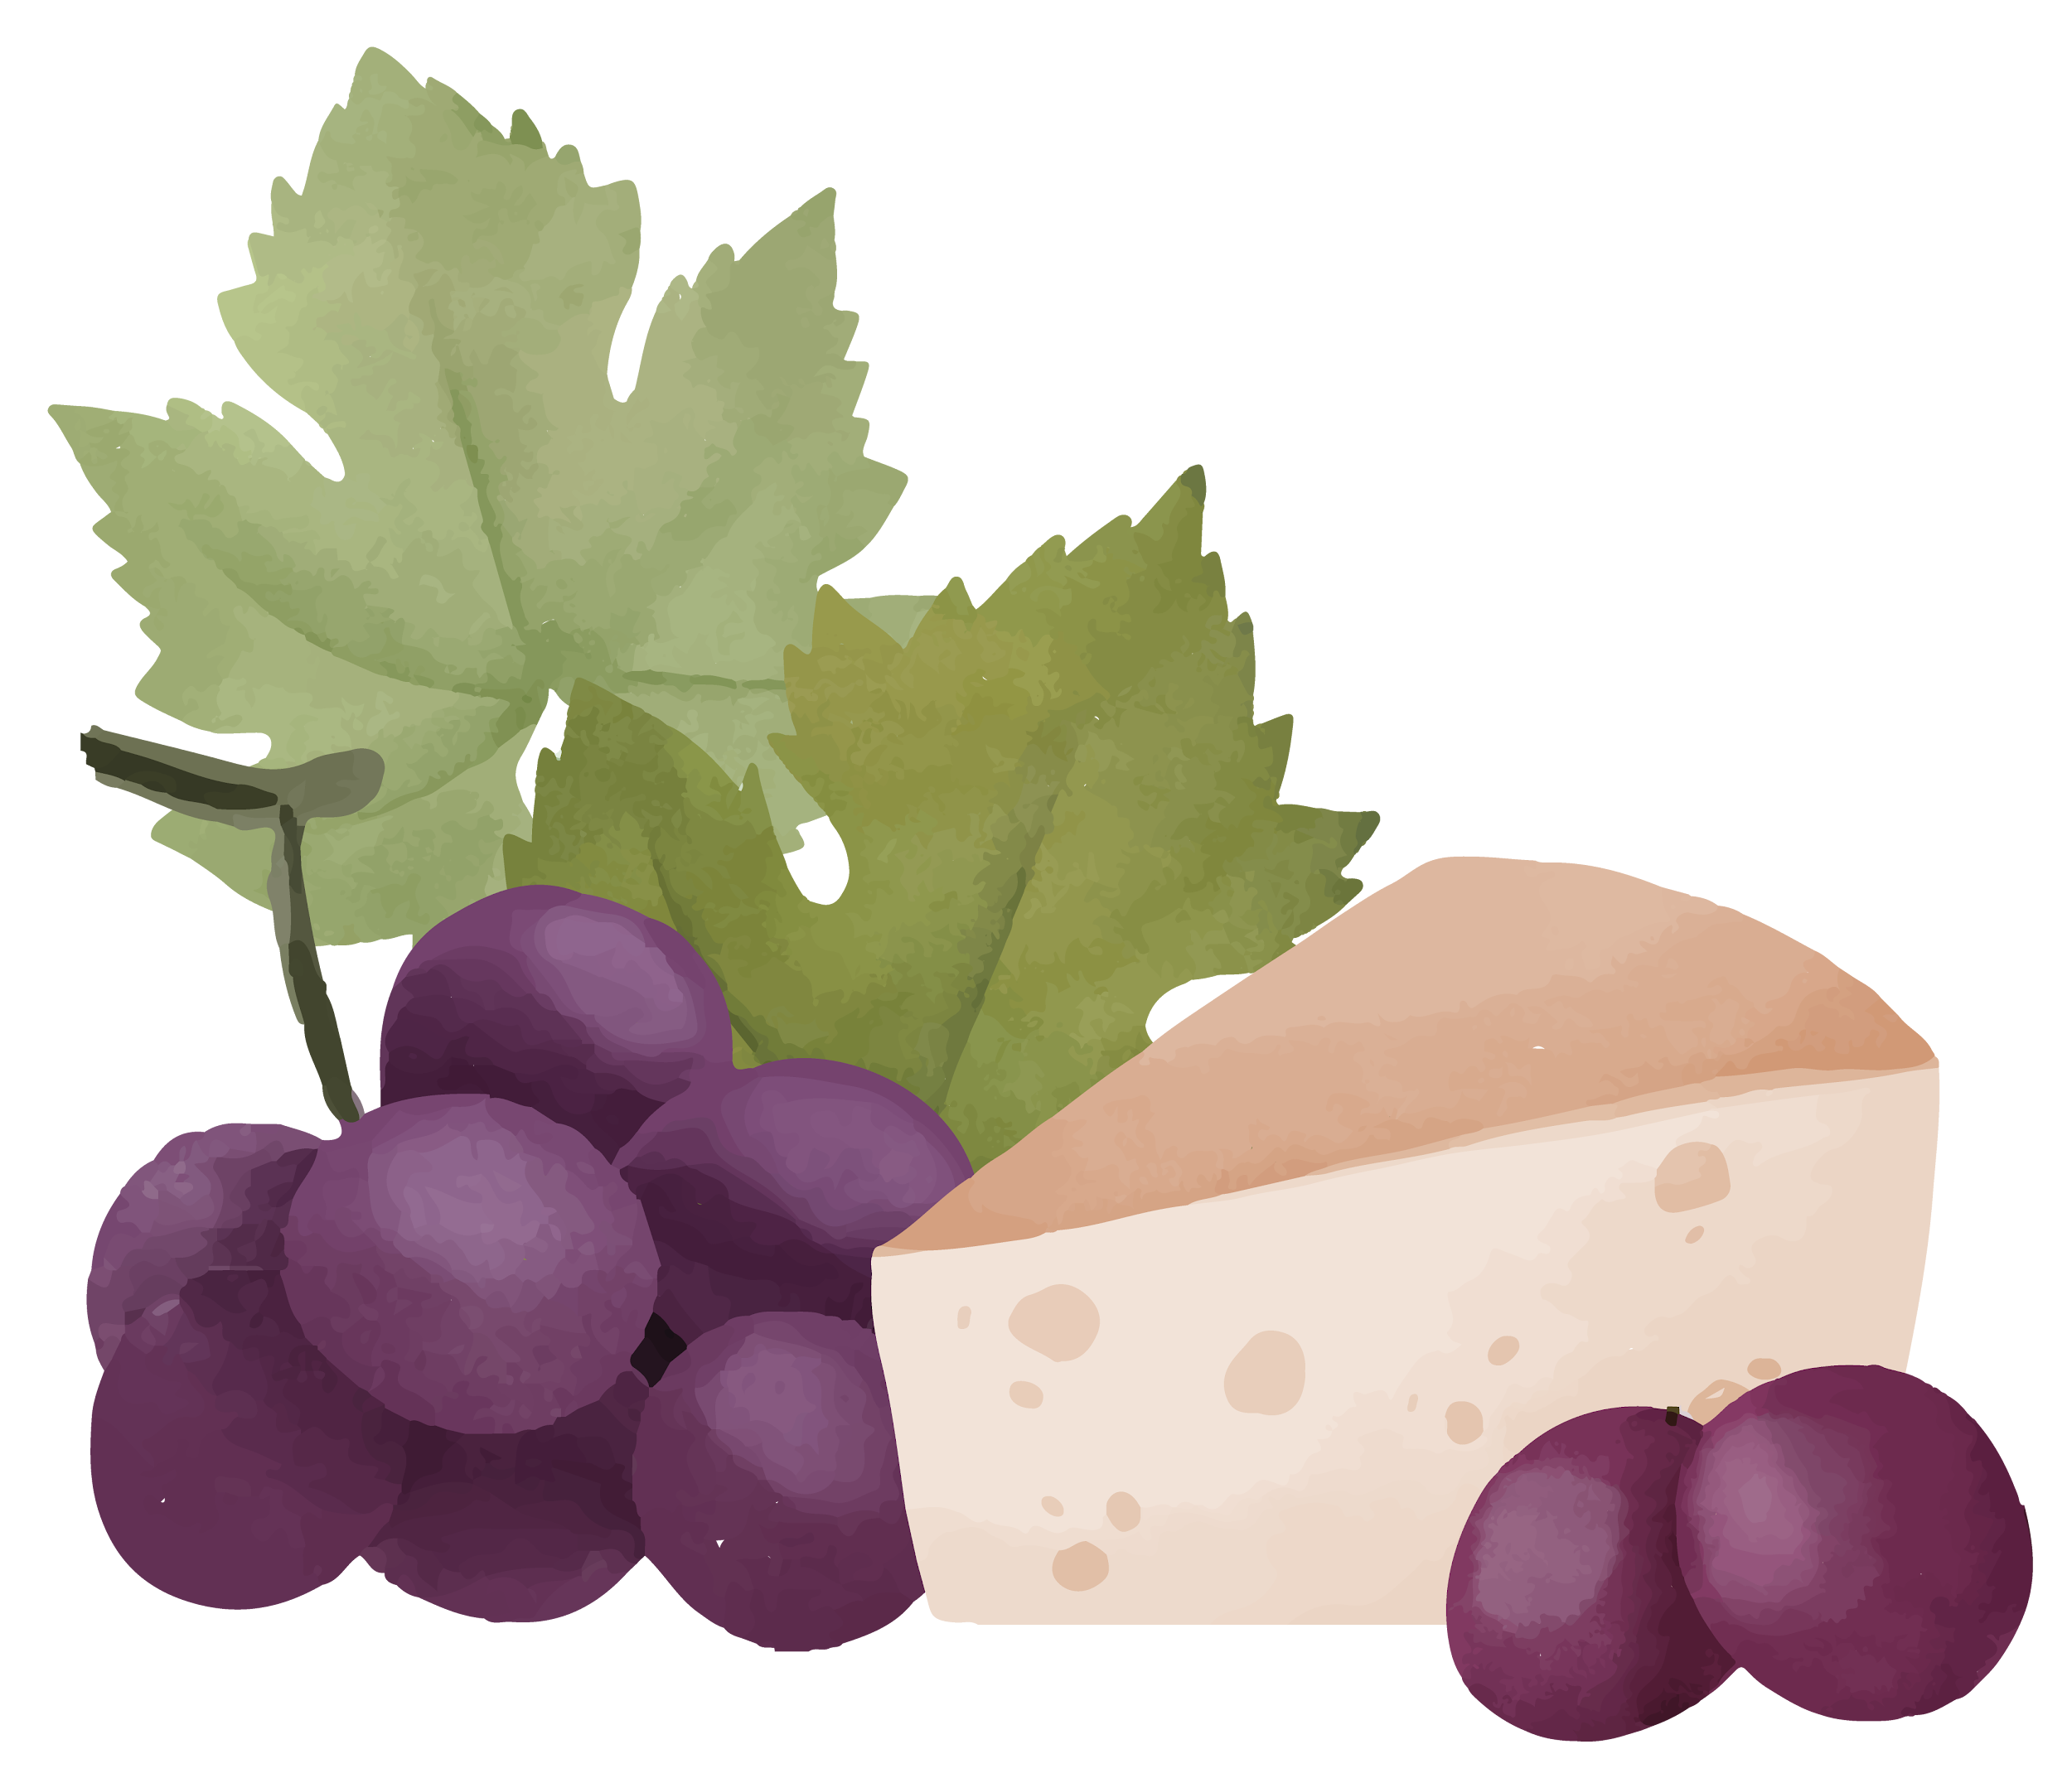
01
Introduction
What is our dataset all about?
Theory lesson

Slide 4
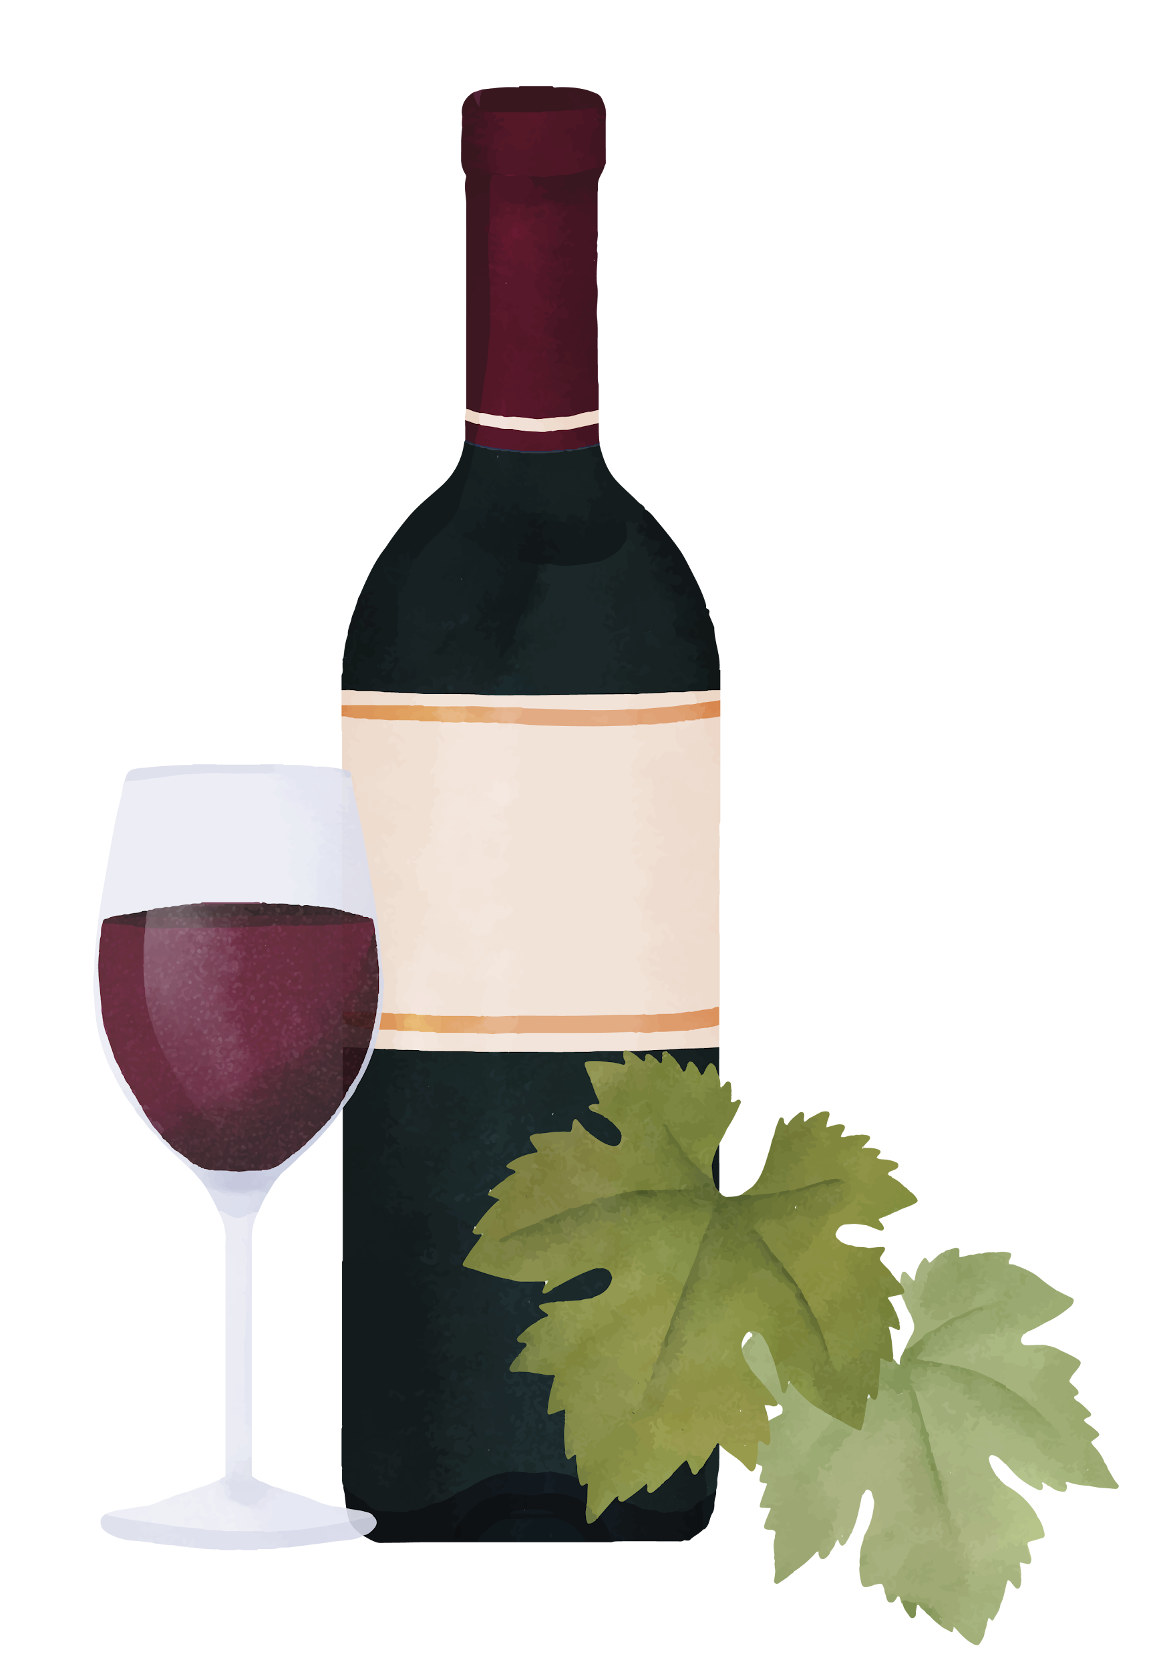
Introduction
The most popular type of wine globally, red wine’s popularity stretches as far back as the sandy deltas of Ancient Egypt.
Data gathered from Kaggle in creating this report, aims to give a detailed overview on red variants of the Portuguese "Vinho Verde" wine.

Slide 5
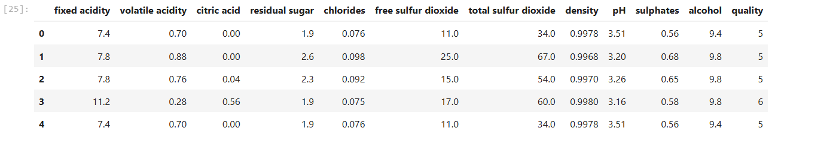
Data Collection and Preprocessing
Kaggle Dataset: Red Wine Quality
This dataset has 12 columns and 1599 rows

Slide 6
02
Data Visualization
What trends does our dataset display? How did we use this to pick a ML model?
Theory lesson

Slide 7
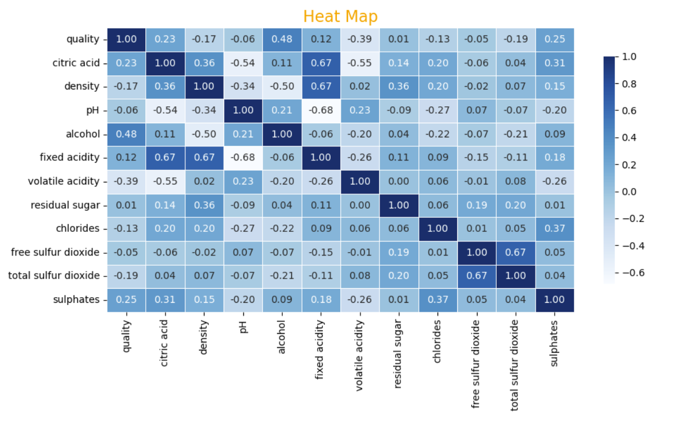
Data Visualization: Heat Map
Heat Maps visualizes the correlation matrix of selected columns in our dataset.
The heatmap ranges from 1 to -1, indicating high correlation and low correlation respectively.

Slide 8
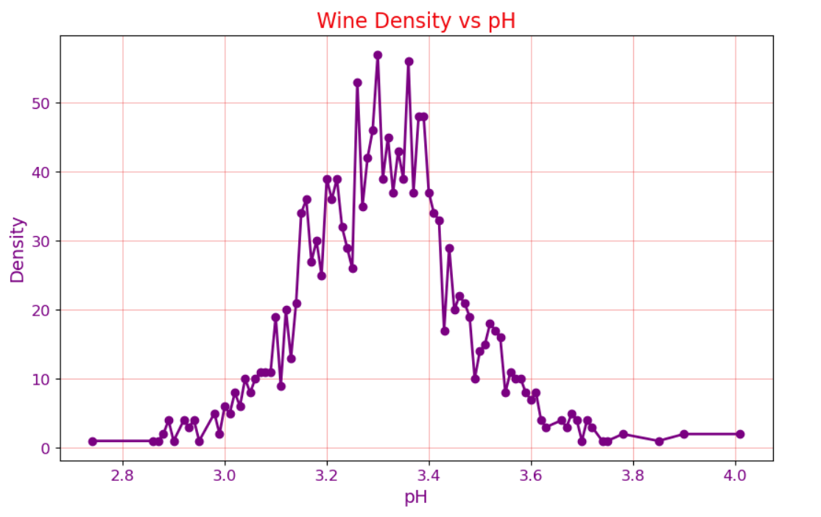
Data Visualization: Line Graph
This line graph shows the relationship between the Wine Density and pH.
The density peaks when the pH level is 3 which indicates acidity.

Slide 9
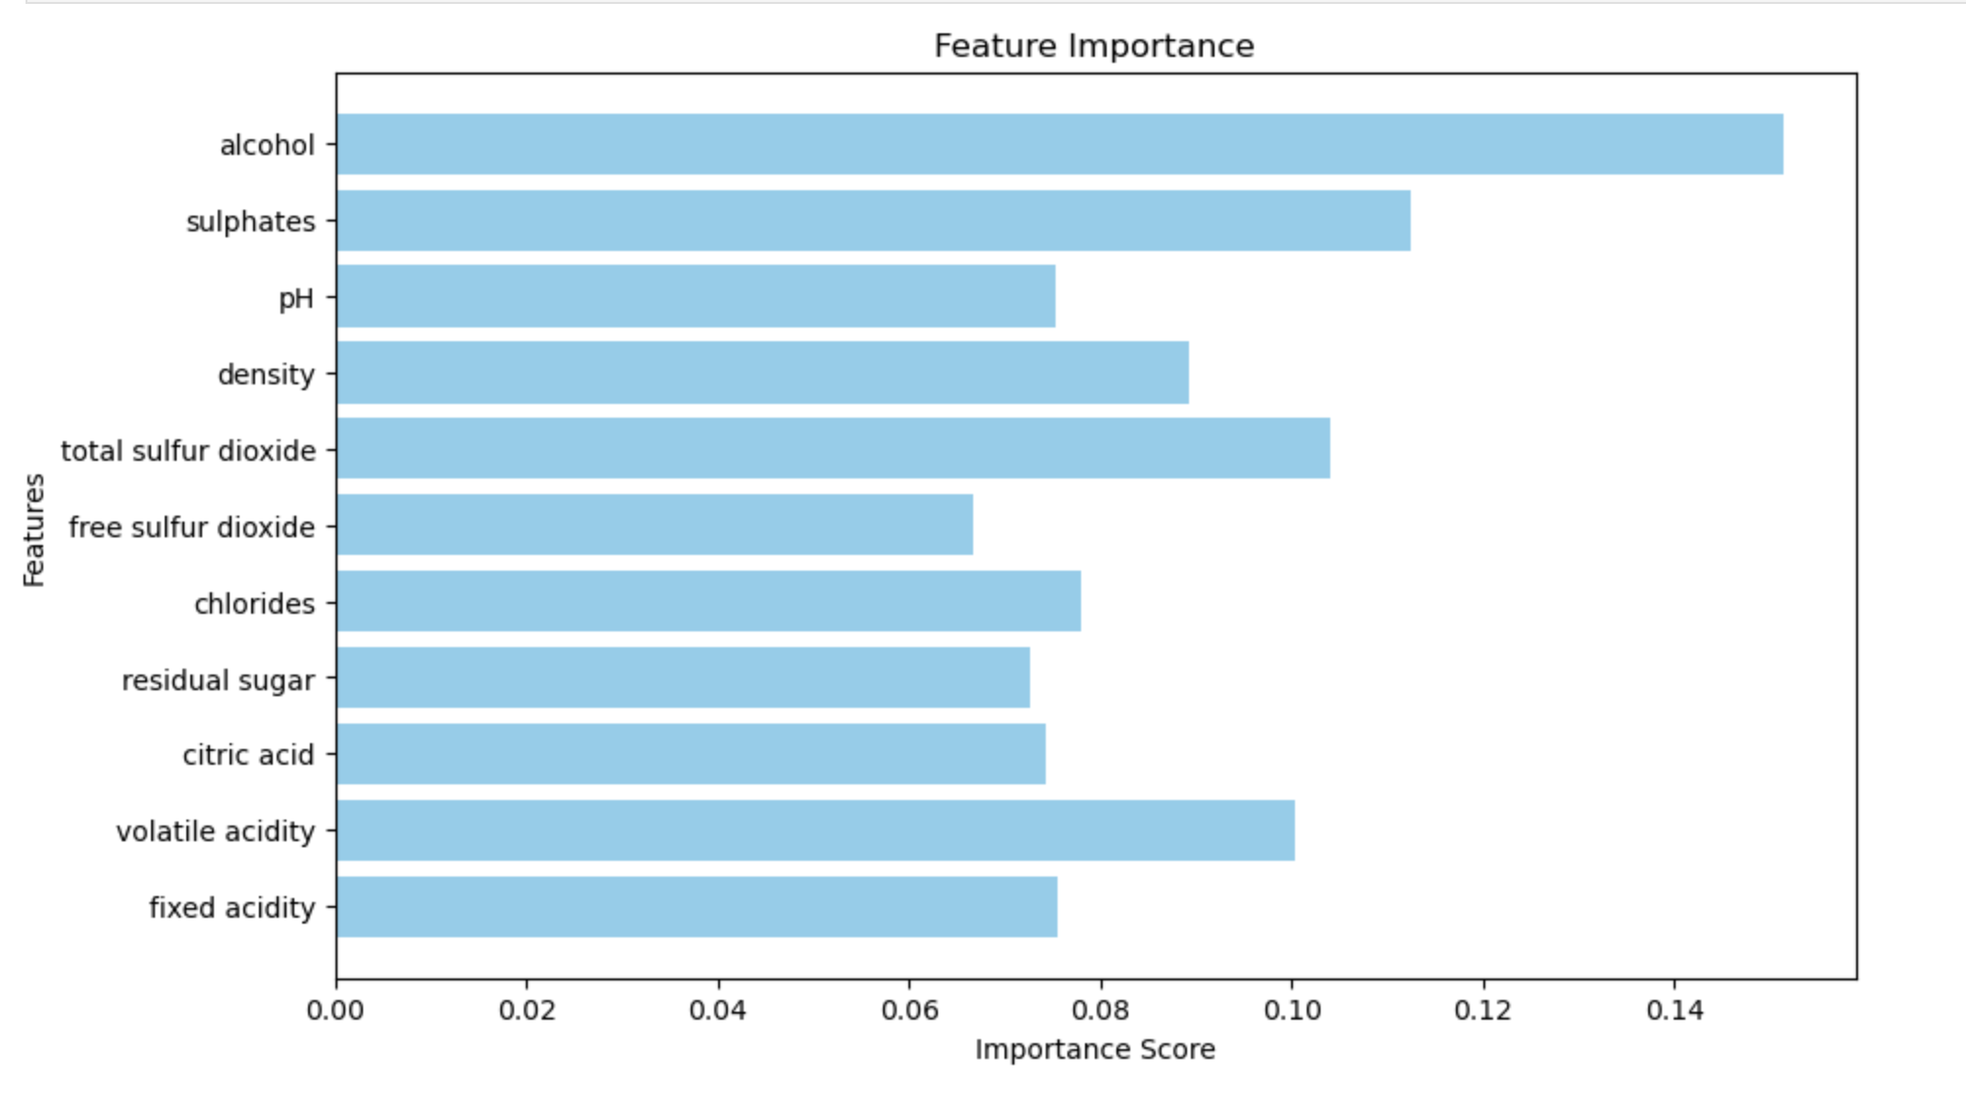
Data Visualization: Bar Graph
In Tree-Based Models (like Random Forest): Feature importance is calculated based on the reduction in impurity (e.g., Gini impurity or entropy) when the feature is used to split data in decision trees. Features that result in larger reductions in impurity are considered more important. In General: High importance: Features that significantly influence the target variable. Low importance: Features that have little to no influence on predictions.

Slide 10
03
Decision Tree
Decision Tree implementation and what the final accuracy score value means?
Theory lesson

Slide 11
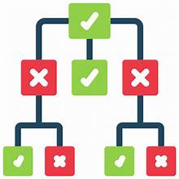
Why Decision Tree?
To determine the Machine Learning Models to use for this dataset, we analyzed the columns provided, and looked for any noticeable patterns.
Decision Tree is one of the Machine Learning Models applied on the features in this Dataset because,
It break down the data into if-else conditions. (Ex. If the wine is high in sugar, then predict the quality being high)
Its ability to handle mixed data types via encoding, which assigns categorical data a number

Slide 12
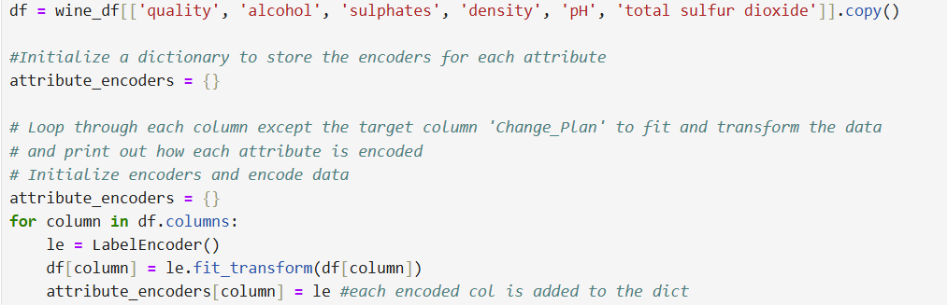
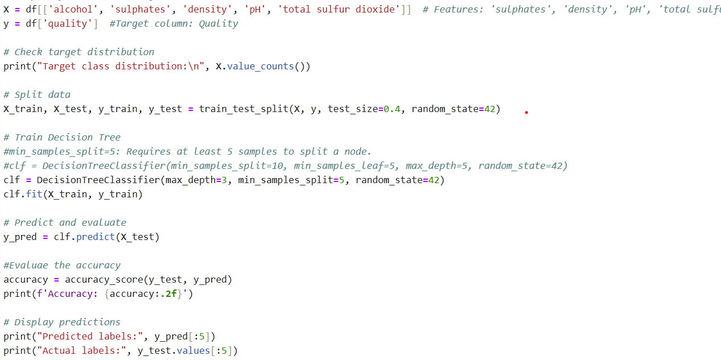
Implementation
Based on the relationships i was able to detect and test, I choose features 'sulphates’, ‘alcohol’ ,'density', 'pH', 'total sulfur dioxide' on the target ‘quality’.
Encoded all relevant columns with a loop and applied the Decision Tree model to the encoded data.
Used predict() to determine how well Decision Tree did in predicting the quality value based on the features

Slide 13
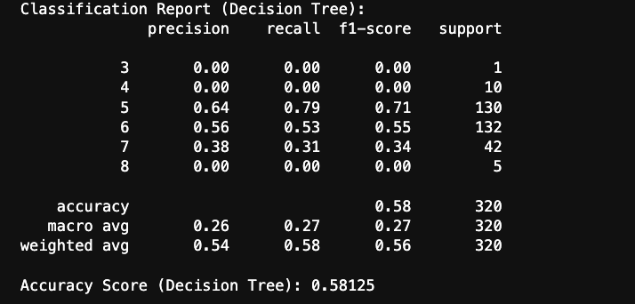
Accuracy Score
The accuracy score computed by the Decision Tree model is 0.58.
Although the score indicates it didn't predict very well. The score of 58% shows the model can predict wine quality better than random guessing.
Some explanations for this score could be that the features don't fully capture all the factors that affect wine quality.
It is also important to note that although the heatmap shows feature correlations with ‘quality’, correlation doesn’t mean perfect prediction.

Slide 14
04
Random Forest
Random Forest implementation and what the final accuracy score value means?
Theory lesson

Slide 15
Implementation
Steps Taken in the Random Forest Model to improve the accuracy :
Data Splitting:
Divided the dataset into training (80%) and testing (20%) sets to evaluate the model's performance.
Hyperparameter Tuning with GridSearchCV:
Defined a hyperparameter grid:
n_estimators: Number of decision trees.
max_depth: Maximum depth of each tree.
min_samples_split: Minimum samples required to split a node.
Used 5-fold cross-validation to evaluate combinations of hyperparameters for the best configuration.
Selected the best parameters based on accuracy.
Handling Class Imbalance:
Calculated class weights using the training data to ensure fair representation of underrepresented wine quality labels.
Applied class_weight='balanced' in the Random Forest model for automatic adjustment of weights.
Model Training:
Trained the Random Forest Classifier using the optimal hyperparameters from GridSearchCV.

Slide 16
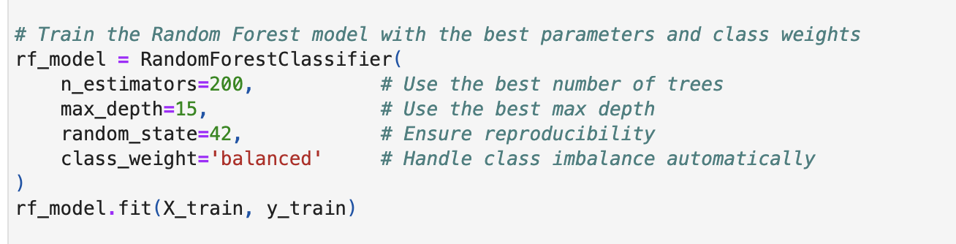
Implementation

Slide 17
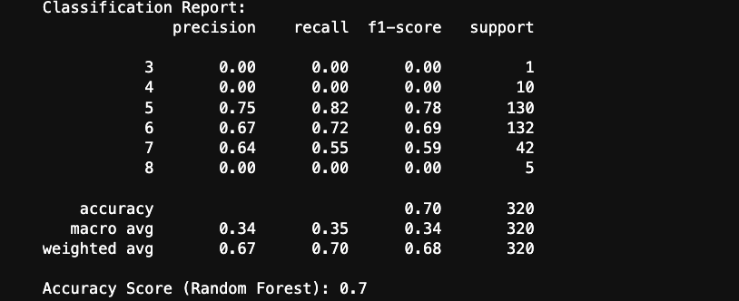
Accuracy Score
- Accuracy: The model achieved 70% accuracy, reflecting good overall performance.
- Good Performance for Classes 5 and 6: High precision, recall, and F1-scores (e.g., 0.78 for Class 5 and 0.69 for Class 6), indicating strong predictions for these classes.
- Weighted Averages: Weighted scores (e.g., F1-score: 0.68) highlight the model's effectiveness for the more frequent classes.

Slide 18
Conclusion
RandomForest did a better job on our features because…..
Class Imbalance Handling: Random Forest performed better due to its ability to incorporate class_weight='balanced', addressing the underrepresented classes (3, 4, 8) more effectively than a single Decision Tree.
Reduced Overfitting: While the Decision Tree likely overfit the training data, Random Forest’s ensemble approach averaged multiple trees, reducing overfitting and providing a more generalized performance.

Slide 19

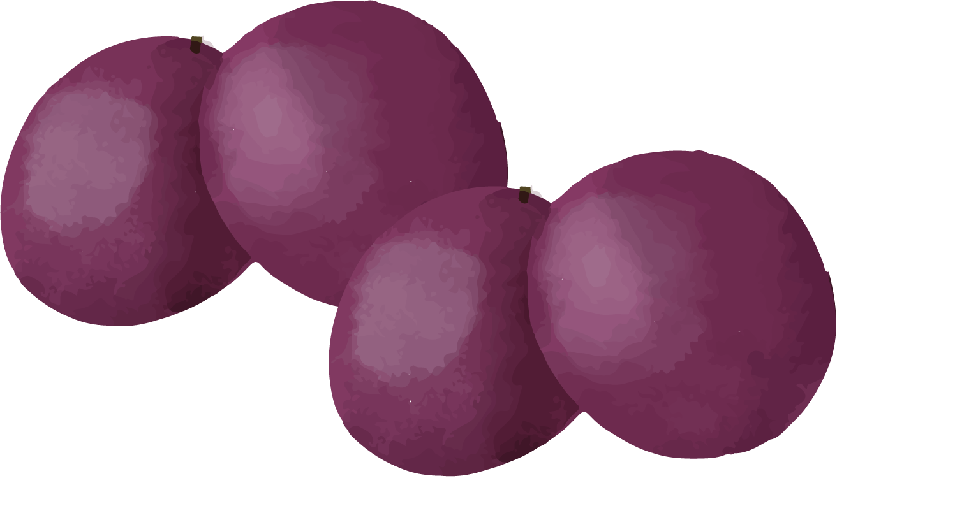
Thanks!
Please keep this slide for attribution

